Slide 1
Demystifying Hardware for Game Developers

Slide 2

HELLO!
I am Pablo Oyarzo
Space, Hardware and Startups.
You can find me at oyarzo.space

Slide 3

https://www.facebook.com/groups/DominicanHardwareCommunity/

Slide 4
Case
Hardware isn’t hard… anymore

Slide 5

GameBoy Advance
And derivatives were my favorite console

Slide 6


Slide 7


Slide 8
Few Years later
After learning electronics and so on...

Slide 9
Dissecting GBA
Hardware isn’t hard… anymore

Slide 10
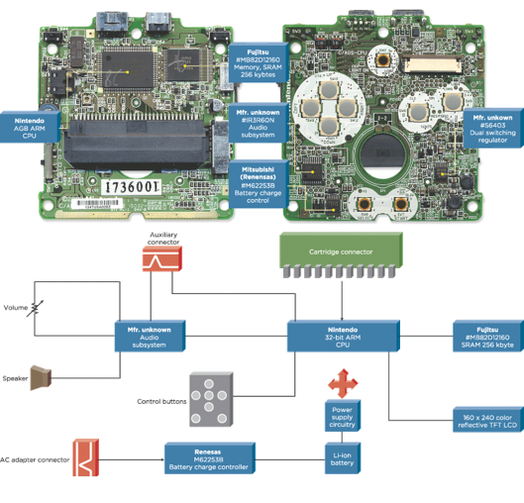
iFixit Links
Gameboy Advance
Gameboy Advance SP

Slide 11
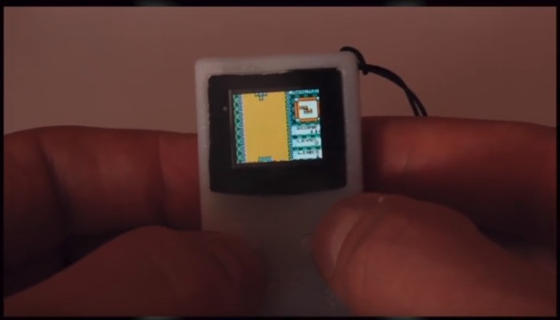
The Tiniest Game Boy for Your Keychain

Slide 12


Slide 13
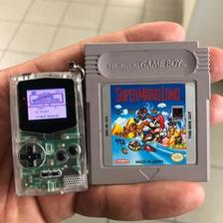
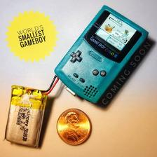
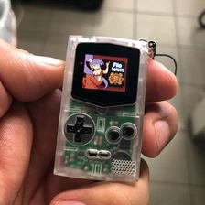

Slide 14
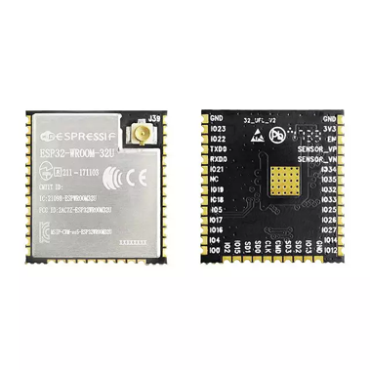
ESP32
2 cores 32bit
160MHz (240)
8mb flash
520kb sram
2 I2C, 2 I2S, 3 UART, 4 SPI
16 GPIO
Wifi, BLE,etc

Slide 15
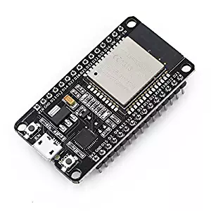
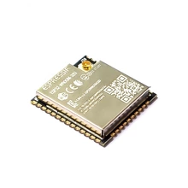
$10
$5
AMZ
Alibaba

Slide 16
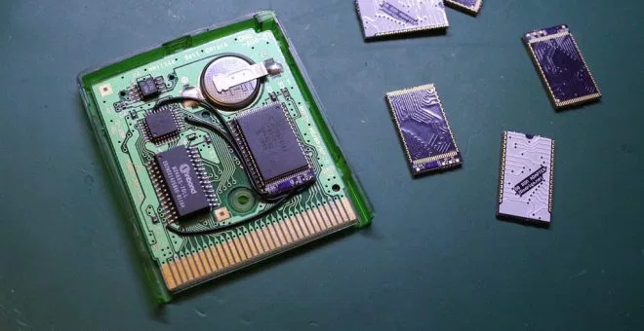
Re-programmable Game Boy cartridge

Slide 17
Dissecting Switch
Hardware isn’t hard… anymore

Slide 18
Base

Slide 19
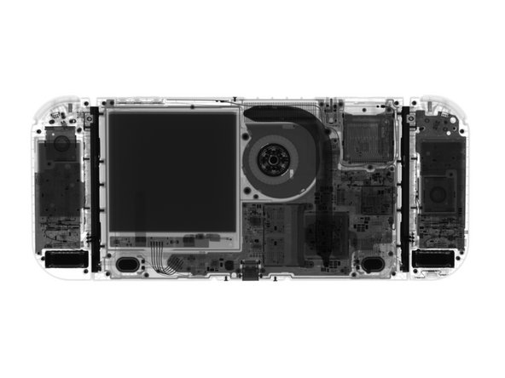
Switch Teardown iFixit

Slide 20
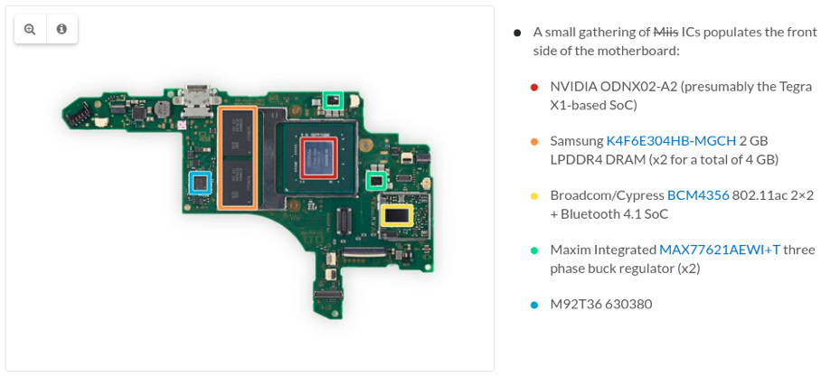

Slide 21
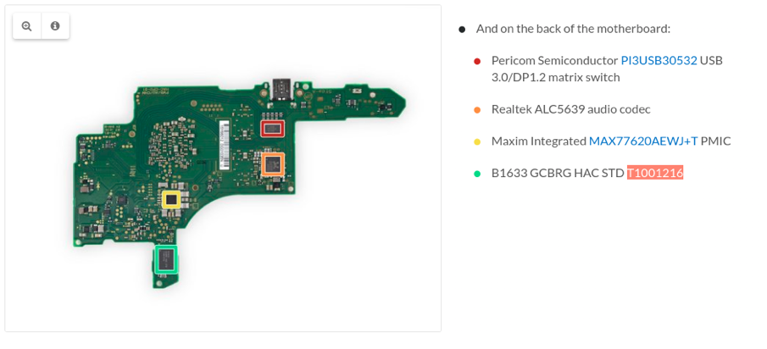

Slide 22
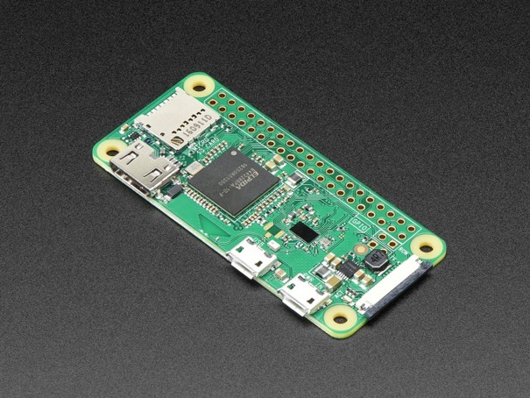
$10
Adafruit
Raspberry Pi Zero W
single-core CPU
1GHz
512MB RAM
Microsd
Mini HDMI and USB On-The-Go ports
Composite video and reset headers
16 GPIO
Wifi, BLE...

Slide 23
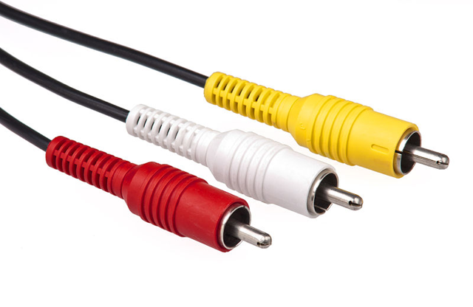
Composite Video

Slide 24
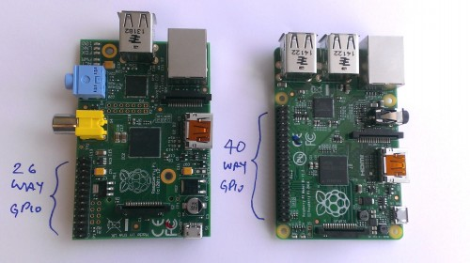

Slide 25
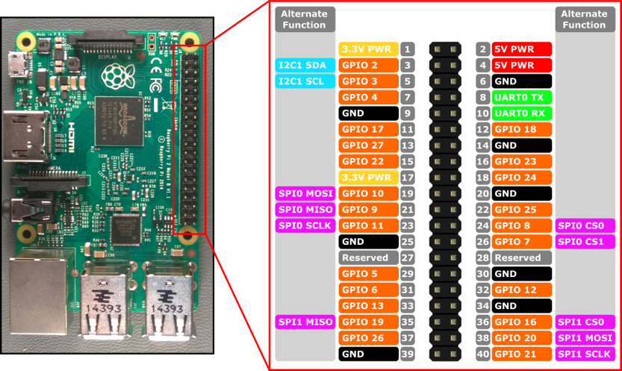

Slide 26
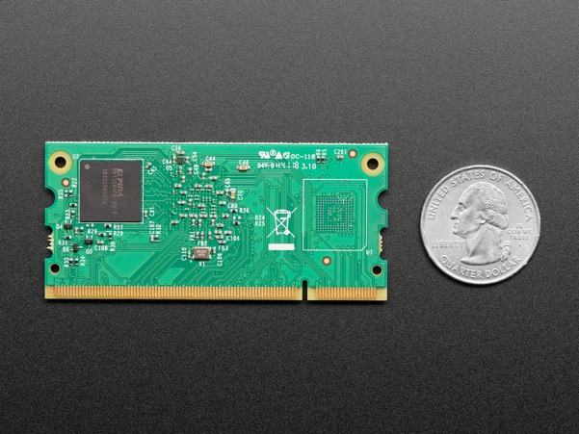
$25
Adafruit
Raspberry Pi Compute Module 3+ Lite
single-core CPU
1GHz
1GB RAM
DDR2 SODIMM form factor
No wifi, bt

Slide 27
Joycon

Slide 28
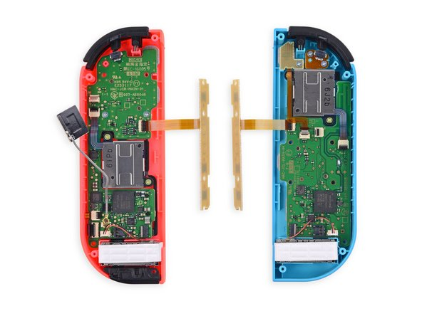
Switch Teardown iFixit

Slide 29
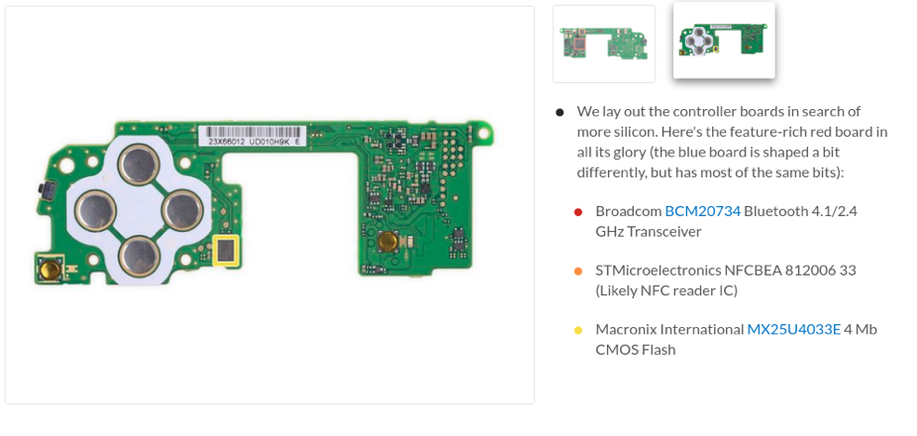

Slide 30
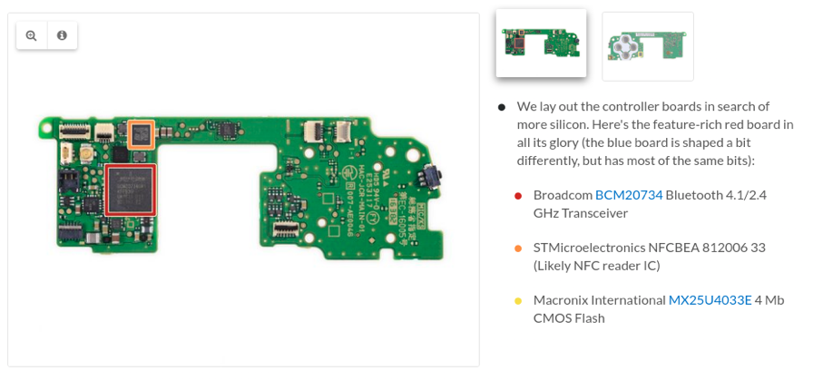

Slide 31
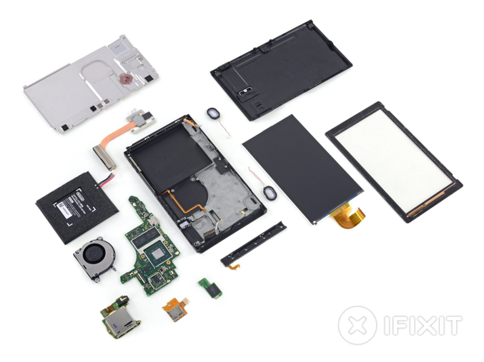
Switch Teardown iFixit

Slide 32
DIY modules

Slide 33
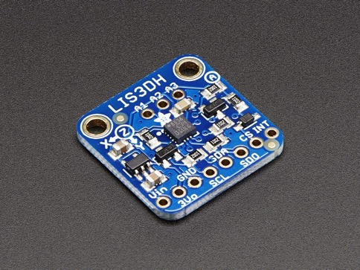
$8
Adafruit
Adafruit LIS3DH Triple-Axis Accelerometer

Slide 34
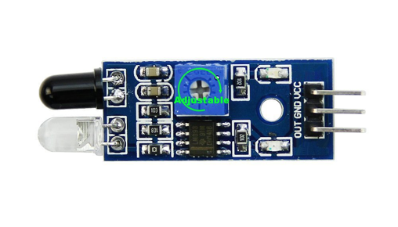
$1
AMZ
OSOYOO IR Infrared arduino

Slide 35
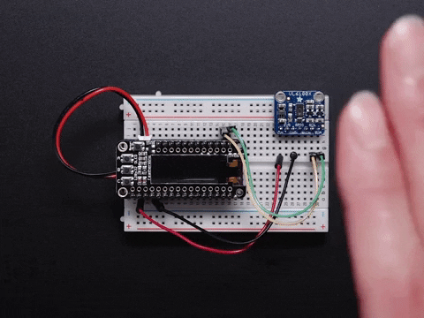
$15
Adafruit
Adafruit VL6180X Time of Flight Distance Ranging Sensor (VL6180)

Slide 36
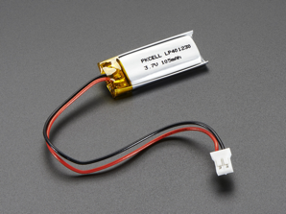
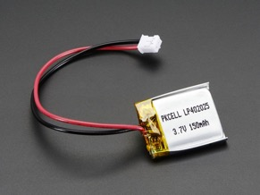
$7
$6
Adafruit
Adafruit
Lithium Ion Polymer Battery - 3.7v 100mAh
Lithium Ion Polymer Battery - 3.7v 150mAh

Slide 37
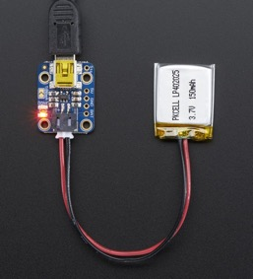
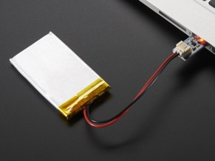
$7
$6
Adafruit
Adafruit
Adafruit Mini Lipo w/Mini-B USB Jack - USB LiIon/LiPoly charger - v1
Adafruit Micro Lipo - USB LiIon/LiPoly charger - v1

Slide 38
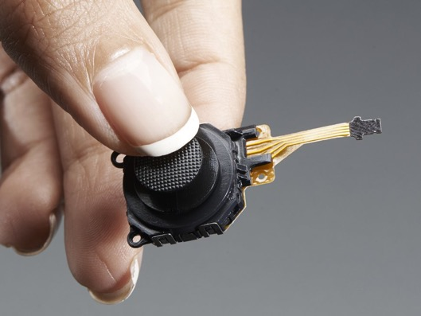
$5
Adafruit
PSP 3000 2-Axis Analog Thumb Joystick

Slide 39
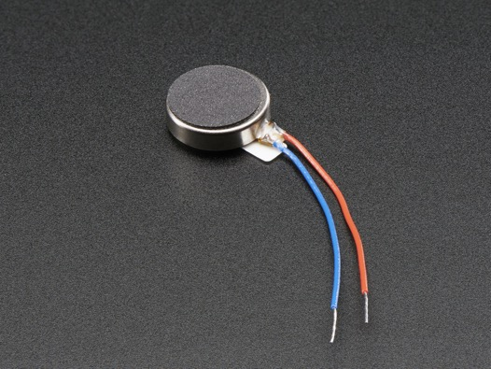
$2
Adafruit
Vibrating Mini Motor Disc

Slide 40
Programming before vs now
Hardware isn’t hard… anymore

Slide 41
Back then

Slide 42
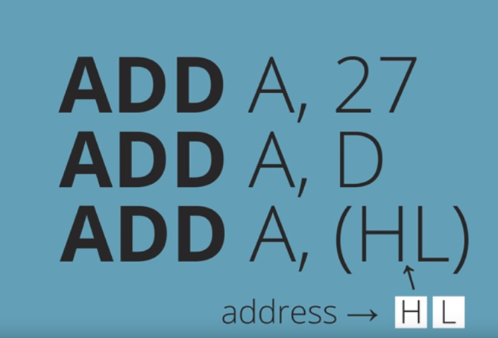
GBA Hardware Autopsy Youtube

Slide 43
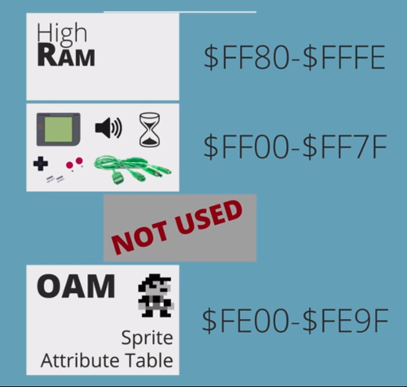
GBA Hardware Autopsy Youtube

Slide 44
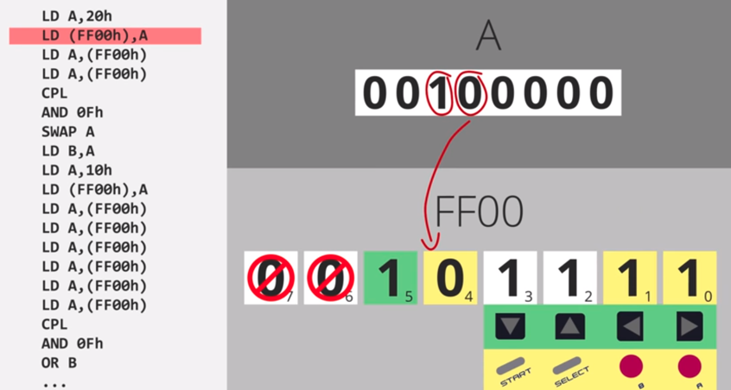
GBA Hardware Autopsy Youtube

Slide 45
Now

Slide 46
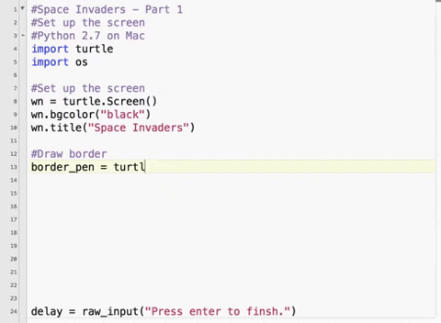

Slide 47
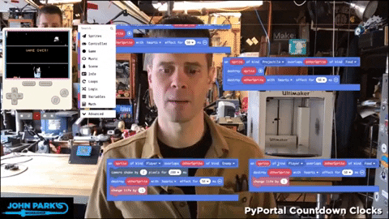

Slide 48
Other consoles
Hardware isn’t hard… anymore… uhum

Slide 49
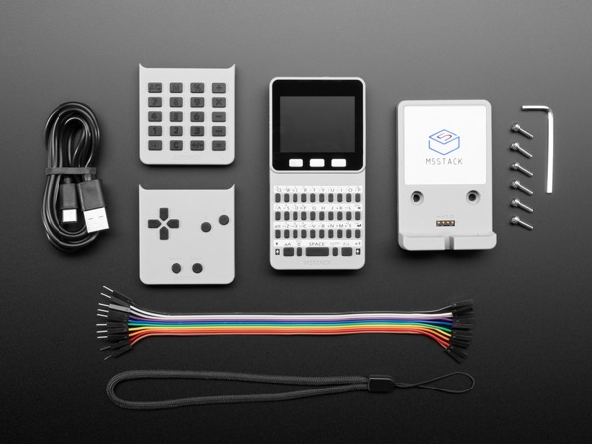
$70
Adafruit
M5Stack FACES ESP32 Pocket Computer - Keyboard, Game, Calculator

Slide 50
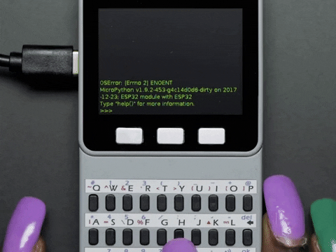

Slide 51
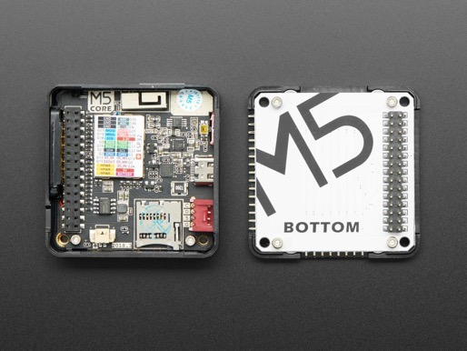
$35
Adafruit
M5Stack Basic Core IoT Development Kit - ESP32 Dev Board

Slide 52
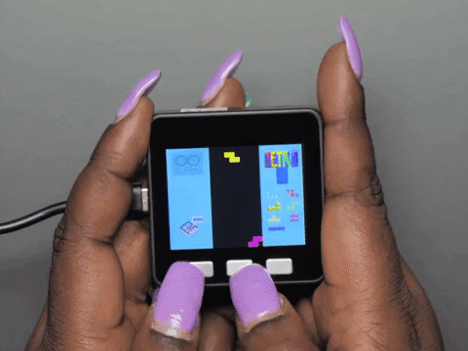

Slide 53
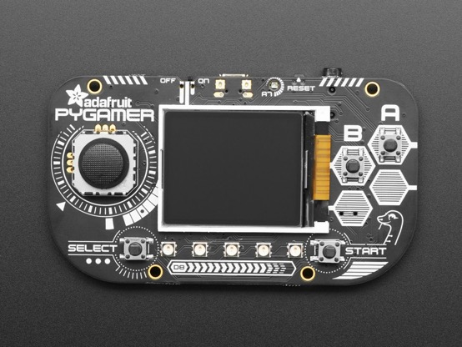
$40
Adafruit
Adafruit PyGamer for MakeCode Arcade, CircuitPython or Arduino

Slide 54
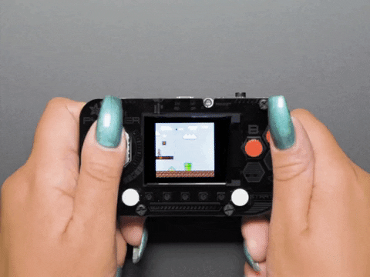

Slide 55
THANKS!
Any questions?
You can find me at
@oyarzo.pablo
oyarzo.space

